Slide 1
Anglia Ruskin University
School of Computing and Information Science
Neural Computing and Deep Learning
MOD 006568
Week 7: Deep Transfer Learning
Dr Vitaliy Milke
PhD in Computer Science and Machine Learning
MSc in Computer Science
MSc in Rocket Engineering
vitaliy.milke@aru.ac.uk
vmilke@gmail.com

Slide 2
Neural Computing and
Deep Learning
MOD 006568
Revision
So far…Special Neural Network Architectures:
CNNs,
RNNs,
MLPs,
Transformers
- Images, sequences,
- NLP, sequences,
- other problems, including Images
- NLP, LLMs

Slide 3
Neural Computing and
Deep Learning
MOD 006568
Revision
Training process:
Weights coefficients updating
Using backpropagation
Using optimisers
This Session…
Deep Transfer Learning

Slide 4
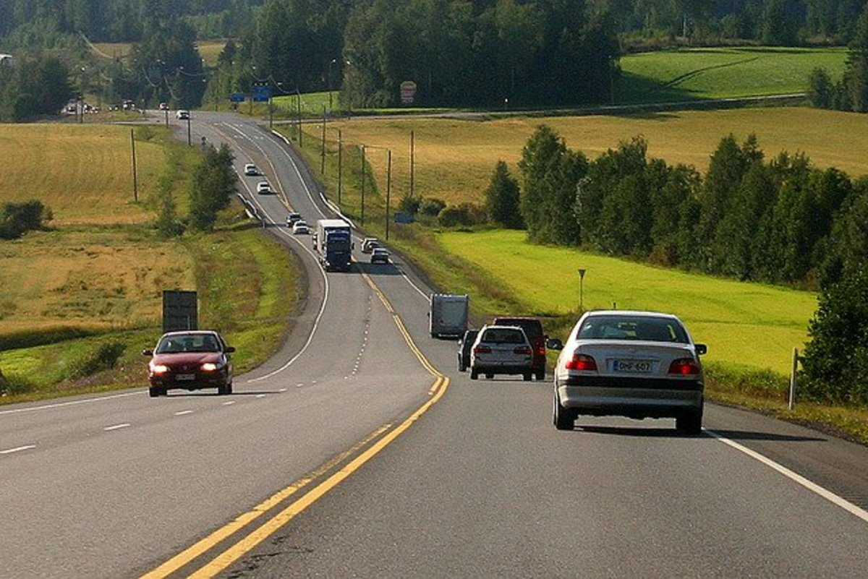
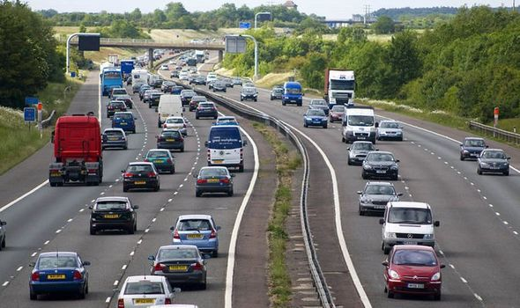
Neural Computing and
Deep Learning
MOD 006568
Differences
Will you start learning car from scratch after moving to a different country?
Transfer prior experience, adapt to a new domain

Slide 5
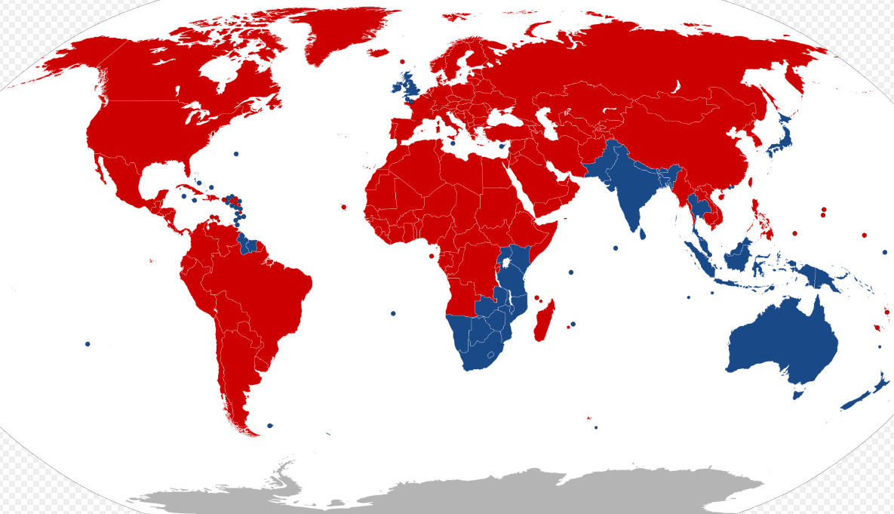

Neural Computing and
Deep Learning
MOD 006568
Left & Right-Hand Traffic

Slide 6
Neural Computing and
Deep Learning
MOD 006568
How do Humans learn?
Humans don’t learn everything from scratch!
Riding a Motor Bike
– Easier if you ride cycle/car!
Learning French
- Easier if you know English?
Transfer our Learning to new domain!
https://towardsdatascience.com/a-comprehensive-hands-on-guide-to-transfer-learning-with-real-world-applications-in-deep-learning-212bf3b2f27a

Slide 7
Neural Computing and
Deep Learning
MOD 006568
Some problems with Neural Network
Takes a long time
Requires managing huge dataset
More difficult to tune hyperparameters
Expensive
Many hours on rented GPU instance(s)
Electricity cost on owned hardware
Everyone wants to use powerful models to solve their own problems!

Slide 8
Neural Computing and
Deep Learning
MOD 006568
Transfer Learning
Transfer Learning - Introduction

Slide 9
Neural Computing and
Deep Learning
MOD 006568
Comparison with Traditional Learning

Slide 10
Neural Computing and
Deep Learning
MOD 006568
Comparison with Traditional Learning

Slide 11
Neural Computing and
Deep Learning
MOD 006568
General CNN Template
What if the most decision-making for classification comes at the final layer?
convolutions
fully connected
softmax classifier

Slide 12
We could simply use the rest of the network as is and learn weights for a new final layer
Neural Computing and
Deep Learning
MOD 006568
New Model (Classifier)
new classifier
convolutions
fully connected
softmax classifier

Slide 13
We only train weights for the last layer
Neural Computing and
Deep Learning
MOD 006568
New Model (Classifier)
learn weights here
The rest stay constant (can also train a bit for fine-tuning)

Slide 14
This technique is called transfer learning
Neural Computing and
Deep Learning
MOD 006568
New Model (Classifier)
Bootstrap your custom model from similar models
Saves days or weeks of training time

Slide 15
Neural Computing and
Deep Learning
MOD 006568
Transfer Learning and Fine-Tuning
learn weights here
The rest stay constant - it's frozen
The whole classifier should be re-trained

Slide 16
Neural Computing and
Deep Learning
MOD 006568
Deep Transfer Learning and Fine-Tuning
learn weights here
The rest stay constant - it's frozen
The whole classifier and part of CNN
should be re-trained

Slide 17
Neural Computing and
Deep Learning
MOD 006568
Deep Transfer Learning and Fine-Tuning
learn weights here
The rest stay constant - it's frozen
The whole classifier and part of CNN
should be re-trained

Slide 18
Neural Computing and
Deep Learning
MOD 006568
Transfer Learning Pipeline
1. Take Pre-training model
2. Freezing
3. Adding new layers
4. Re-training
5. Fine Tuning

Slide 19
Neural Computing and
Deep Learning
MOD 006568
Transfer Learning (inside)
Idea: layers in the trained model might generalise. If we just change the later layers, we can use the previously trained model to solve the new problem !

Slide 20
Neural Computing and
Deep Learning
MOD 006568
Transfer Learning (inside)
Idea: layers in the trained model might generalise. If we just change the later layers, we can use the previously trained model to solve the new problem !

Slide 21
Neural Computing and
Deep Learning
MOD 006568
Transfer Learning (inside)
Idea: layers in the trained model might generalise. If we just change the later layers, we can use the previously trained model to solve the new problem !

Slide 22
Neural Computing and
Deep Learning
MOD 006568
Transfer Learning (inside)
Idea: layers in the trained model might generalise. If we just change the later layers, we can use the previously trained model to solve the new problem !

Slide 23
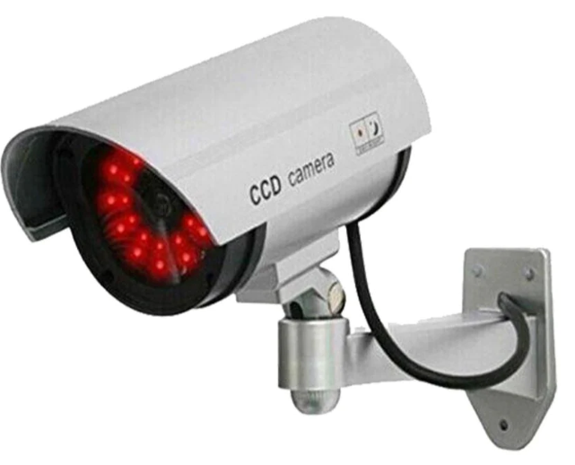
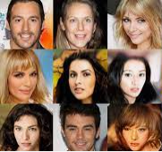
Neural Computing and
Deep Learning
MOD 006568
Transfer Learning (inside)
Idea: layers in the trained model might generalise. If we just change the later layers, we can use the previously trained model to solve the new problem !

Slide 24

Neural Computing and
Deep Learning
MOD 006568
IMAGENET Database
More than 14 million images
More than 21,000 categories
1,000 classes

Slide 25
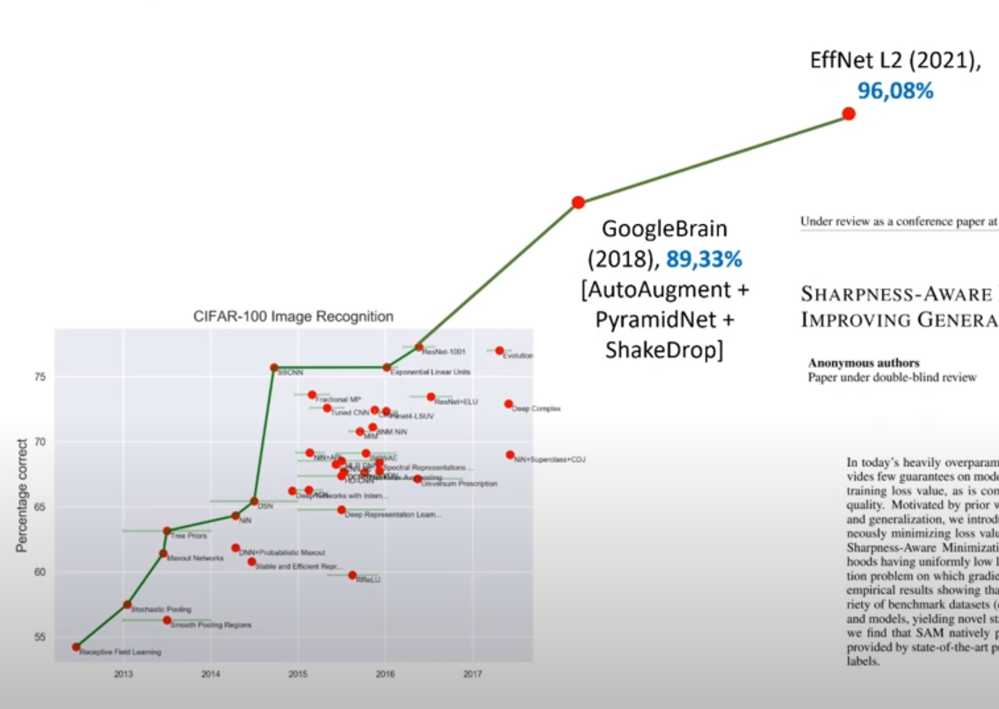
Neural Computing and
Deep Learning
MOD 006568
Pre-trained Models Performance

Slide 26
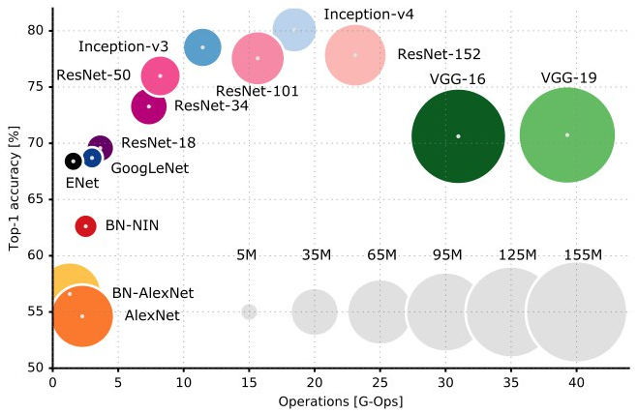
Neural Computing and
Deep Learning
MOD 006568
Pre-trained Models Performance

Slide 27
Neural Computing and
Deep Learning
MOD 006568
VGG-16 (2014)
Deeper Network
https://arxiv.org/pdf/1409.1556.pdf

Slide 28
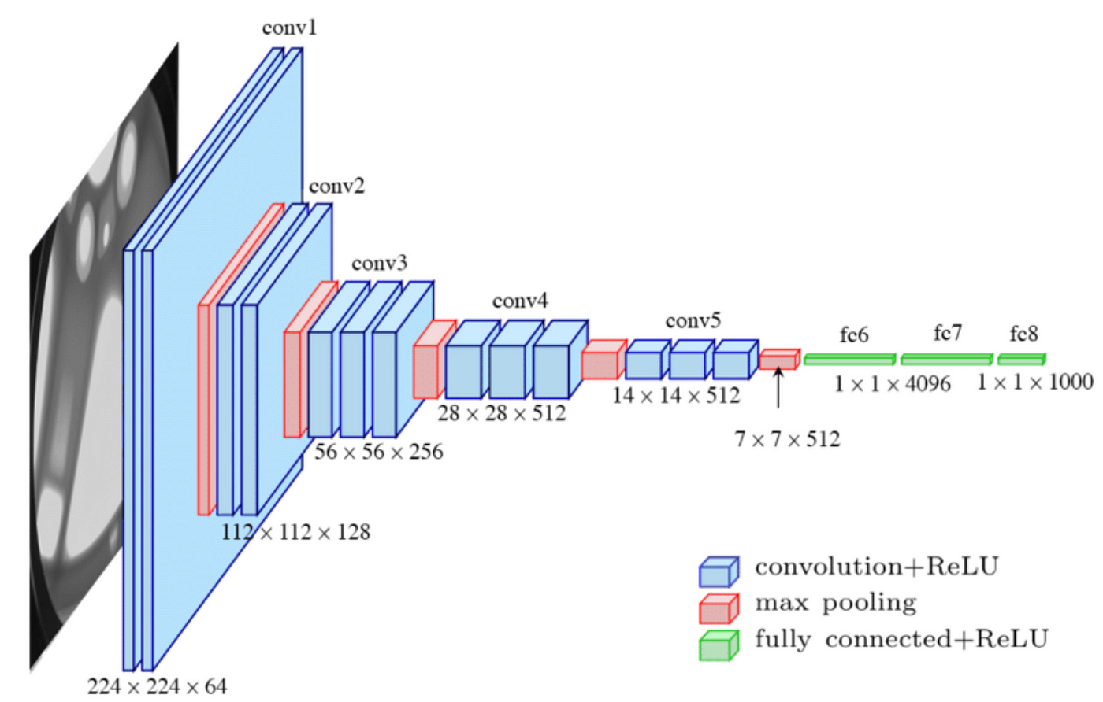
Neural Computing and
Deep Learning
MOD 006568
VGG-16 (2014)

Slide 29
Neural Computing and
Deep Learning
MOD 006568
Pre-trained Models Performance

Slide 30
Neural Computing and
Deep Learning
MOD 006568
Pre-trained Models Performance

Slide 31
Neural Computing and
Deep Learning
MOD 006568
ResNet-50 (2015)
Popularised skip connections, 152 Layers deep!
https://arxiv.org/pdf/1512.03385.pdf

Slide 32
Neural Computing and
Deep Learning
MOD 006568
Pre-trained Models Performance

Slide 33
Neural Computing and
Deep Learning
MOD 006568
Inception-V4 (2016)
More Inception modules
https://arxiv.org/pdf/1602.07261.pdf

Slide 34
Neural Computing and
Deep Learning
MOD 006568
Pre-trained Models Performance

Slide 35
Neural Computing and
Deep Learning
MOD 006568
Common CNN Architectures
ImageNet Data Performance

Slide 36
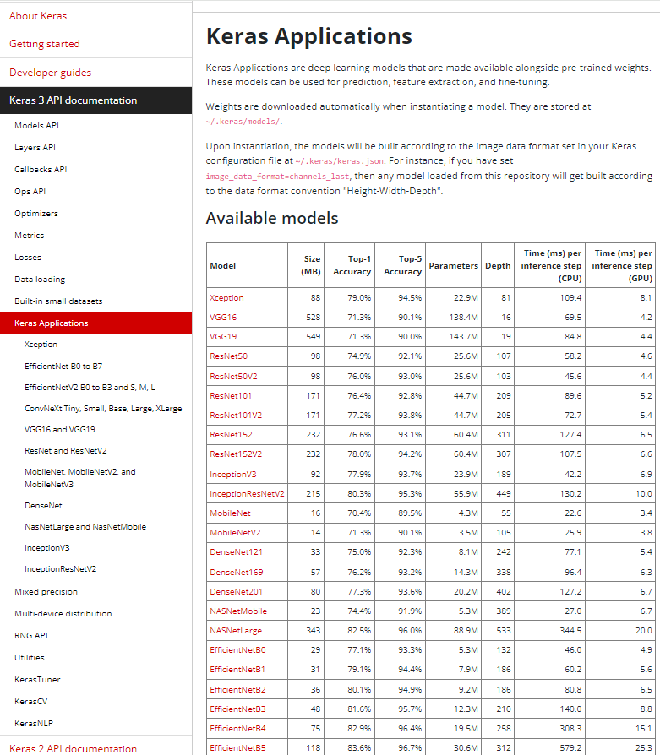
Neural Computing and
Deep Learning
MOD 006568
https://keras.io/api/applications/#usage-examples-for-image-classification-models

Slide 37
Neural Computing and
Deep Learning
MOD 006568
Popular Open-source LLMs for 2024
1. DeepSeek-R1
2. Mistral 7B
3. LLama 3.3 70B (Large Language Model Meta AI)
4. Phi 3 Mini (Microsoft)
5. StarCoder (from BigScience)
6. Polycoder (from Anthropic)
7. Falcon 40B
8. GPT-NeoX
9. BLOOM
10. MPT-30B
11. BERT
12. T5

Slide 38
Neural Computing and
Deep Learning
MOD 006568
More Resources
Survey on Transfer Learning:
https://www.cse.ust.hk/~qyang/Docs/2009/tkde_transfer_learning.pdf
Example Tasks: Cancer Detection
https://www.researchgate.net/publication/328680040_Quantitative_imaging_of_cancer_in_the_postgenomic_era_Radiogenomics_deep_learning_and_habitats_Radiomics_of_Cancer
How transferable are features:
https://arxiv.org/pdf/1411.1792.pdf
Practical Hands-on:
https://github.com/dipanjanS/hands-on-transfer-learning-with-python

Slide 39
Neural Computing and
Deep Learning
MOD 006568
More Resources

Slide 40
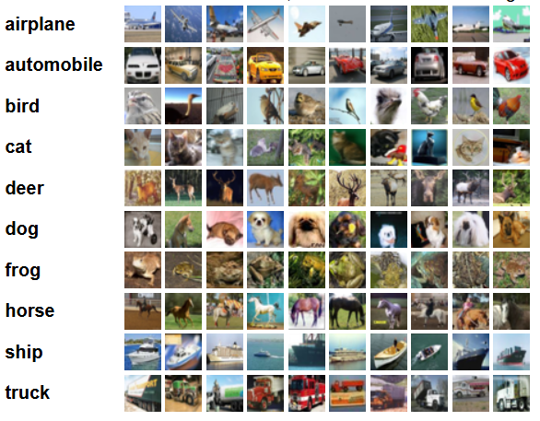
Neural Computing and
Deep Learning
MOD 006568
Practical Session, CIFAR-10
https://www.cs.toronto.edu/~kriz/cifar.html
Notes:
.

Slide 41
Neural Computing and
Deep Learning
MOD 006568
Deep Transfer Learning and Fine-Tuning
learn weights here
The rest stay constant - it's frozen
The whole classifier and part of CNN
should be re-trained

Slide 42
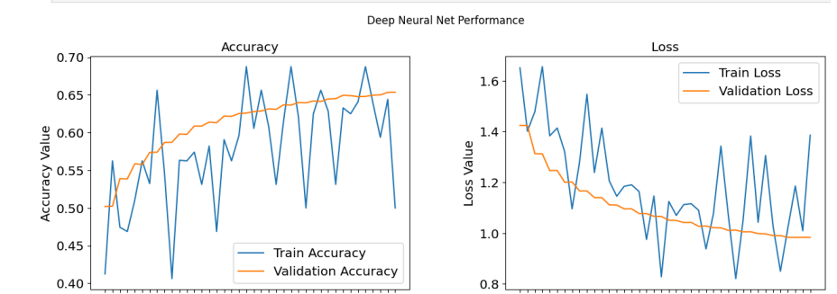
Neural Computing and
Deep Learning
MOD 006568
Practical Session

Slide 43
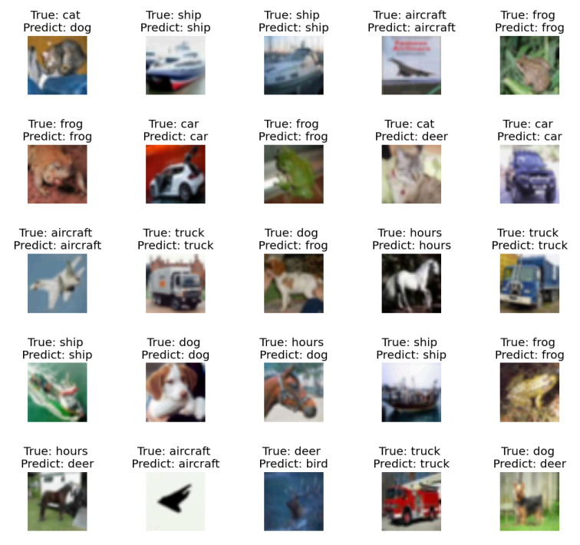
Neural Computing and
Deep Learning
MOD 006568

